Slide 1



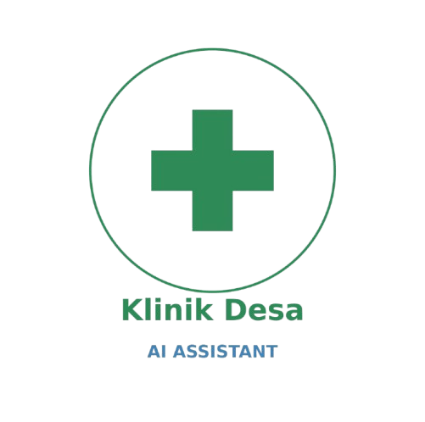


Introducing
Klinik Desa AI Assistant

Slide 2




Powered by
JamAI Base
Built with
Streamlit

Slide 3

Presented by
KKBig
Track:
EmbeddedLLM

Slide 4

The Problems
Our Target & Solution
System Architecture
Our Key Features
Tech Stack
User Journey & Demo
Why Choose US?

Slide 5
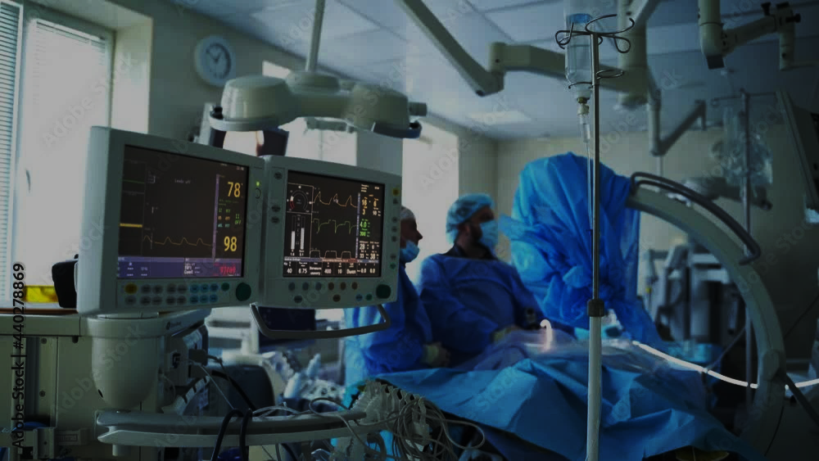
Problem Statement: The “Rural Healthcare Gap"

Slide 6



2
Specialists Scarcity
The Problems
1
3
Burden Overload
Complex SOPS

Slide 7

Our Target & Solution

Slide 8
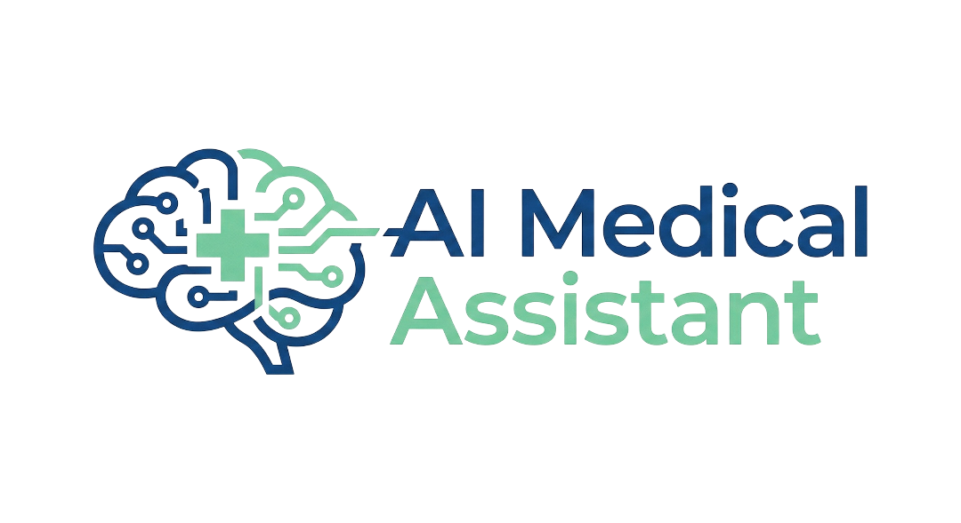
Target Users
Medical Officers in Rural and District Clinics
Junior Doctors in
Busy
Departments

Slide 9
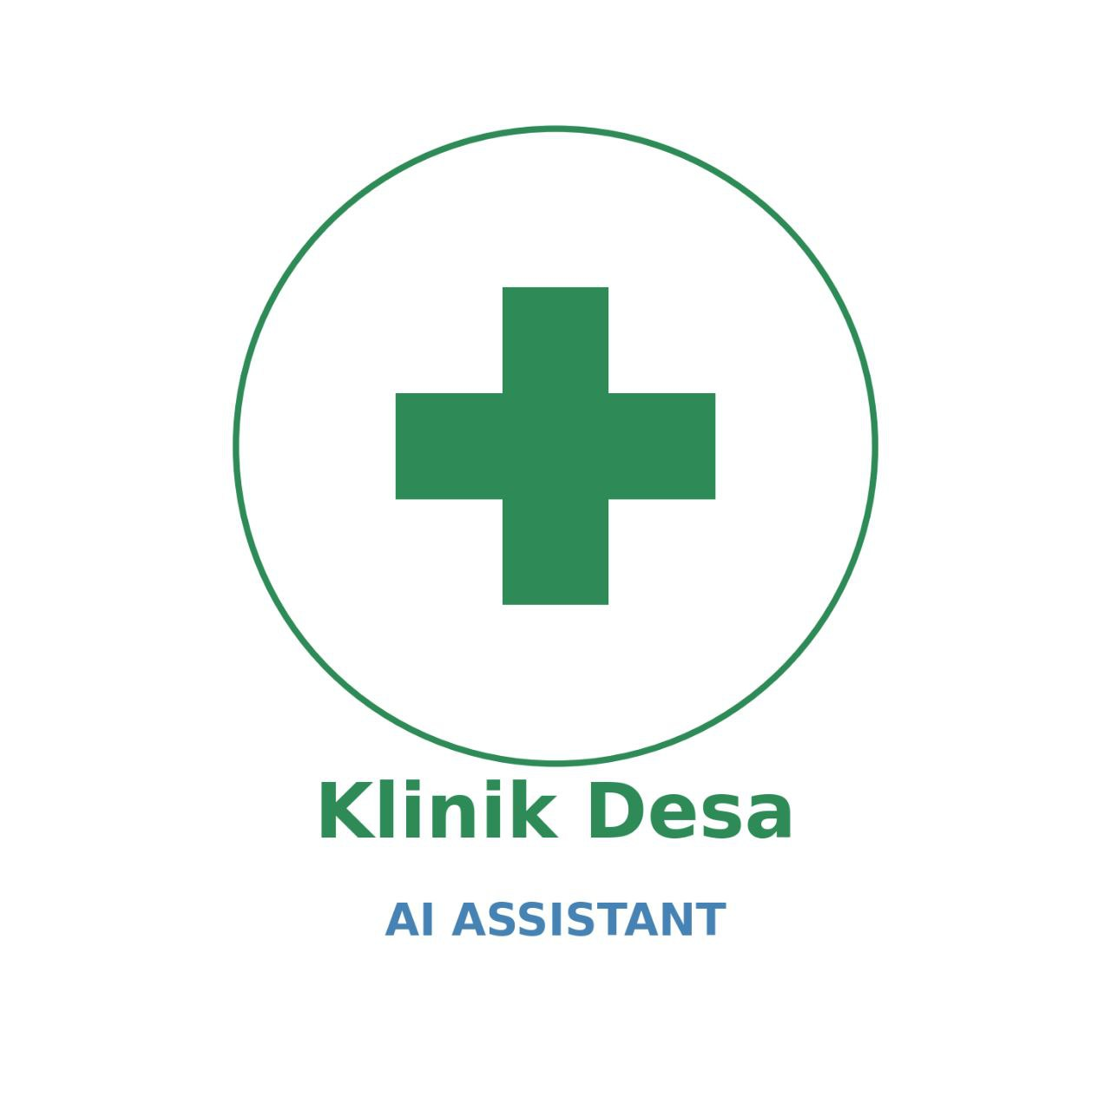
Our Solution
Vision
RAG
Action
Instantly screens CT scans for tumours
Automatically retrieves the correct MOH Referral SOP
Providing a “Digital Second Opinion” to reduce misdiagnosis and streamline patients to major hospital

Slide 10

System Architecture and Data Flow
STEP
01
STEP
02
STEP
03
STEP
04
STEP
05

Slide 11
System Architecture and Data Flow
Multimodal Ingestion
Captures CT scan (image) and Doctor’s voice note (audio) via Streamlit frontend
STEP
02
STEP
03
STEP
04
STEP
05
STEP
01

Slide 12
System Architecture and Data Flow
Multimodal Ingestion
Context Injection layer
Captures CT scan (image) and Doctor’s voice note (audio) via Streamlit frontend
Transcribes audio into text and inject it directly into the Vision Model’s prompt
STEP
03
STEP
04
STEP
05
STEP
01
STEP
02

Slide 13
System Architecture and Data Flow
Multimodal Ingestion
Context Injection layer
Visual Reasoning
Captures CT scan (image) and Doctor’s voice note (audio) via Streamlit frontend
Transcribes audio into text and inject it directly into the Vision Model’s prompt
JamAI’s Action Table to analyze visual data and cross-referencing injected doctor’s context
STEP
04
STEP
05
STEP
01
STEP
02
STEP
03

Slide 14
System Architecture and Data Flow
Multimodal Ingestion
Context Injection layer
Visual Reasoning
Automated RAG Retrieval
Captures CT scan (image) and Doctor’s voice note (audio) via Streamlit frontend
Transcribes audio into text and inject it directly into the Vision Model’s prompt
JamAI’s Action Table to analyze visual data and cross-referencing injected doctor’s context
Queries clinic_knowledge table to retrieve specific MOH Referral SOPs upon diagnosis detection
STEP
05
STEP
01
STEP
02
STEP
03
STEP
04

Slide 15
System Architecture and Data Flow
Multimodal Ingestion
Context Injection layer
Visual Reasoning
Automated RAG Retrieval
SOP-Aligned Synthesis
Queries clinic_knowledge table to retrieve specific MOH Referral SOPs upon diagnosis detection
Combines visual findings, diagnosis and retrieved SOPs to generate actionable Referral Letter
Captures CT scan (image) and Doctor’s voice note (audio) via Streamlit frontend
Transcribes audio into text and inject it directly into the Vision Model’s prompt
JamAI’s Action Table to analyze visual data and cross-referencing injected doctor’s context
STEP
01
STEP
02
STEP
03
STEP
04
STEP
05

Slide 16
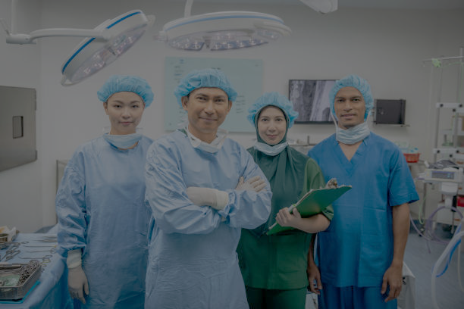
Our
Key Features

Slide 17
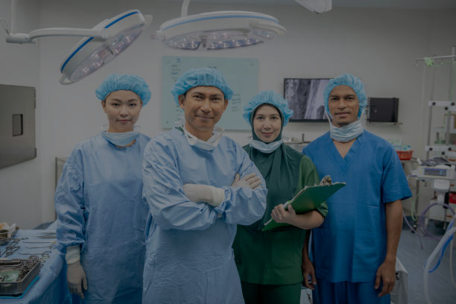
Our Key Features
Multimodal Tumour Detection (Vision+Audio)
Bilingual & Manglish Support
Generates both English and Malay Language to support diverse local medical staff
Handles Malaysian-accented English (Manglish) effectively
Visual Intelligence: Uses ELLM Qwen3 VL 30B
Context Injection: Uses Qwen-2 Audio
Localised RAG (MOH Guidelines)
Workflow Automation (End-to-End)
Implementing knowledge table containing MOH Malaysia Referral Guidelines 2025
Recommend the correct specialist centre
Zero Friction
Actionable Output: Instantly generates a downloadable .txt referral letter

Slide 18
Our Key Features
Multimodal Tumour Detection (Vision+Audio)
Bilingual & Manglish Support
Generates both English and Malay Language to support diverse local medical staff
Handles Malaysian-accented English (Manglish) effectively
Visual Intelligence: Uses ELLM Qwen3 VL 30B
Context Injection: Uses Qwen-2 Audio
Localised RAG (MOH Guidelines)
Workflow Automation (End-to-End)
Implementing knowledge table containing MOH Malaysia Referral Guidelines 2025
Recommend the correct specialist centre
Zero Friction
Actionable Output: Instantly generates a downloadable .txt referral letter

Slide 19
Our Key Features
Multimodal Tumour Detection (Vision+Audio)
Bilingual & Manglish Support
Generates both English and Malay Language to support diverse local medical staff
Handles Malaysian-accented English (Manglish) effectively
Visual Intelligence: Uses ELLM Qwen3 VL 30B
Context Injection: Uses Qwen-2 Audio
Localised RAG (MOH Guidelines)
Workflow Automation (End-to-End)
Implementing knowledge table containing MOH Malaysia Referral Guidelines 2025
Recommend the correct specialist centre
Zero Friction
Actionable Output: Instantly generates a downloadable .txt referral letter

Slide 20
Our Key Features
Multimodal Tumour Detection (Vision+Audio)
Bilingual & Manglish Support
Generates both English and Malay Language to support diverse local medical staff
Handles Malaysian-accented English (Manglish) effectively
Visual Intelligence: Uses ELLM Qwen3 VL 30B
Context Injection: Uses Qwen-2 Audio
Localised RAG (MOH Guidelines)
Workflow Automation (End-to-End)
Implementing knowledge table containing MOH Malaysia Referral Guidelines 2025
Recommend the correct specialist centre
Zero Friction
Actionable Output: Instantly generates a downloadable .txt referral letter

Slide 21
Tech Stack

Slide 22

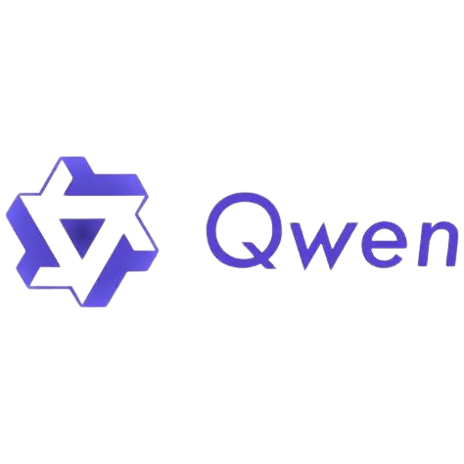
Tech Stack
Frontend Framework
Backend/AI Ops
Streamlit (Python)
LLM Orchestration (JamAI Base)
JamAI components
Models deployed
Action Tables and Knowledge Tables
Qwen3-VL-30B and Qwen-2-Audio-7B
Data Source
Official Malaysia MOH Referral Guidelines

Slide 23

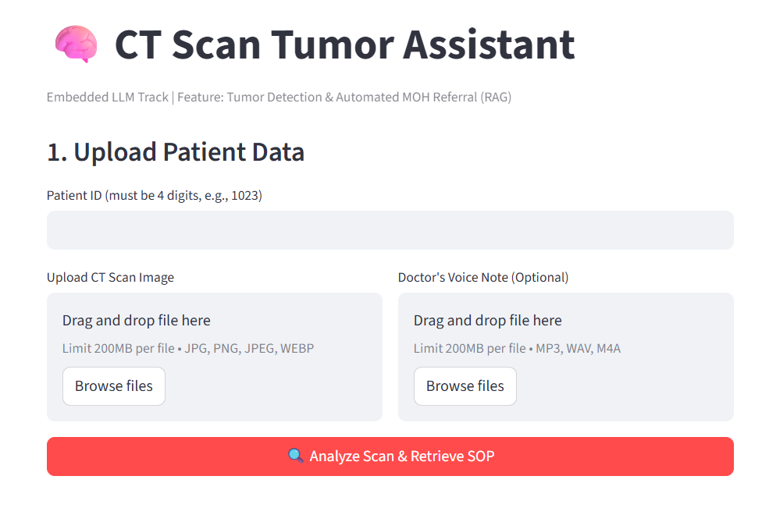
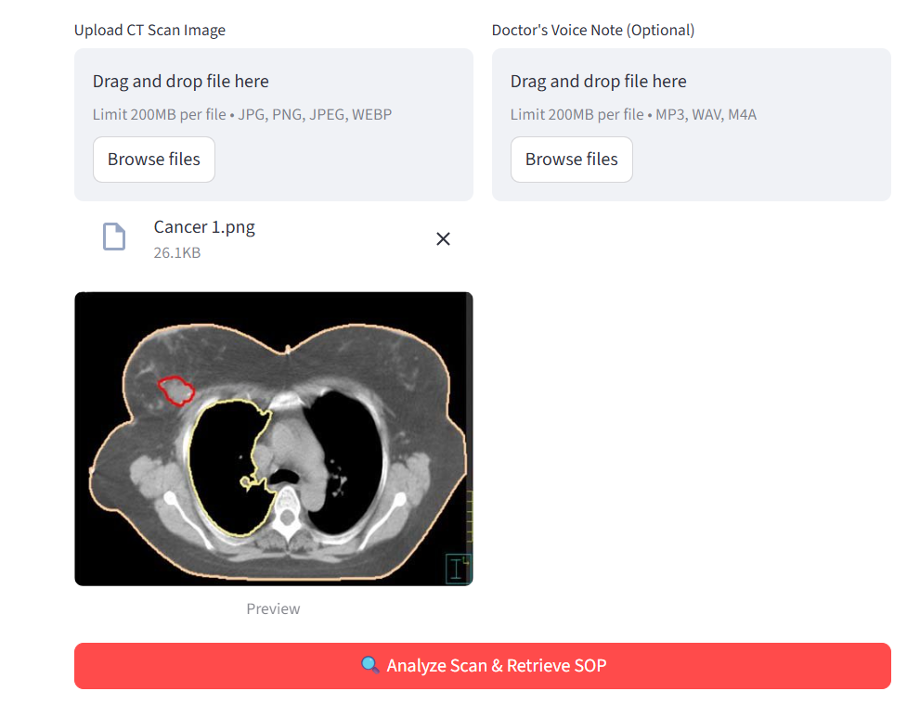
User Journey & Demo
Step 1
Data Ingestion: Input any CT scan files or prescription audio
Step 2
AI Analysis & Diagnosis: Dual-Engine Analysis with JamAI’s vision model

Slide 24
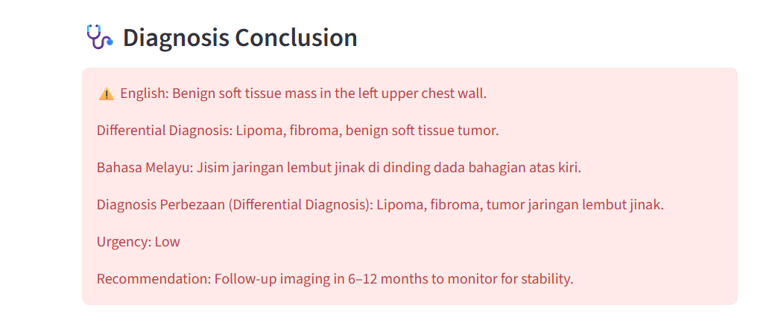
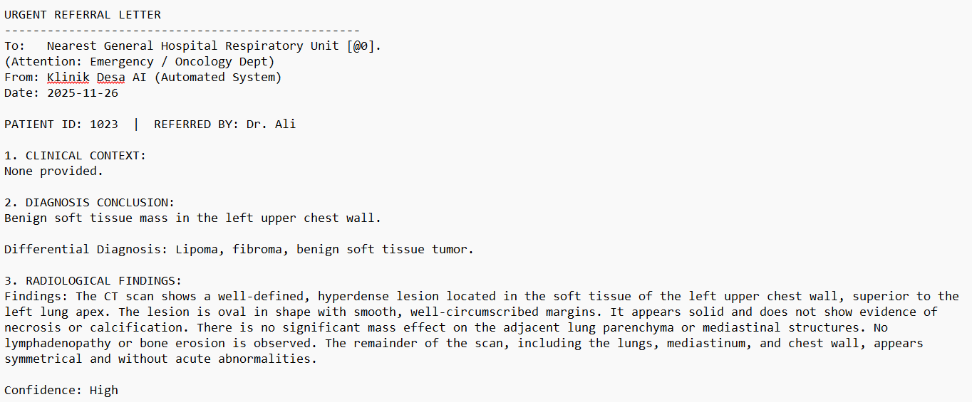
User Journey & Demo
Step 3
Actionable Decision: Automated SOP Retrieval – Hospital Recommendation

Slide 25
Why Klinik Desa AI Assistant?
1
Not Just a Chatbot: We are a Workflow Automation Tool
2
Zero CapEx Implementation: Adopt AI without Constraints
3
Democratizing Specialized Care: Advanced AI Diagnosis
4
Safety & Compliance: Malaysia MOH Guidelines

Slide 26
QnA Session

Slide 27
THANK YOU
Klinik Desa AI Assistant
KKBig

